Slide 1

Hello, Intuit !
Name:
Kimia Hassanzadeh
Degree:
BSc. Software Eng. (Iran)
MSc. Software Eng. & Intelligent Systems (UofA)
Background:
Semantic Web, Machine Learning, Text Processing
Current:
Software Developer

Slide 2
Interests
Fields of Interests:
Pattern Mining, IoT, UI Design
Hobbies:
Playing with new technologies (Arduino, Oculus Rift)
Learning new skills
Watching Ted talks
Reading Books esp. Biographies/WW1
Drawing classic animation !

Slide 3
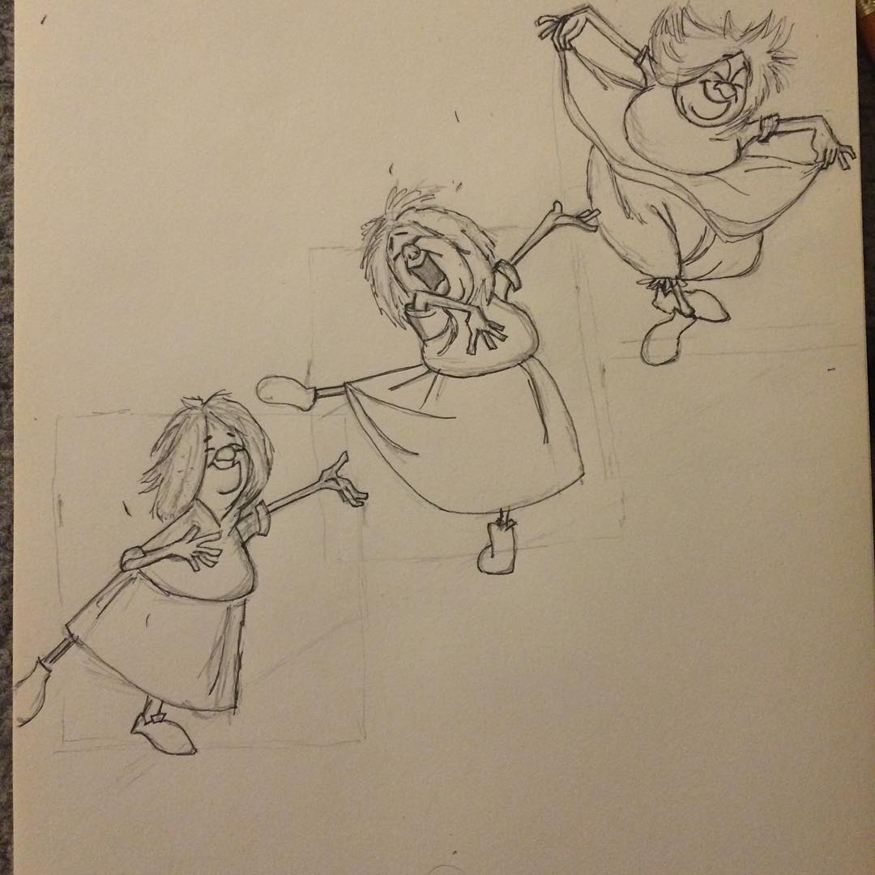


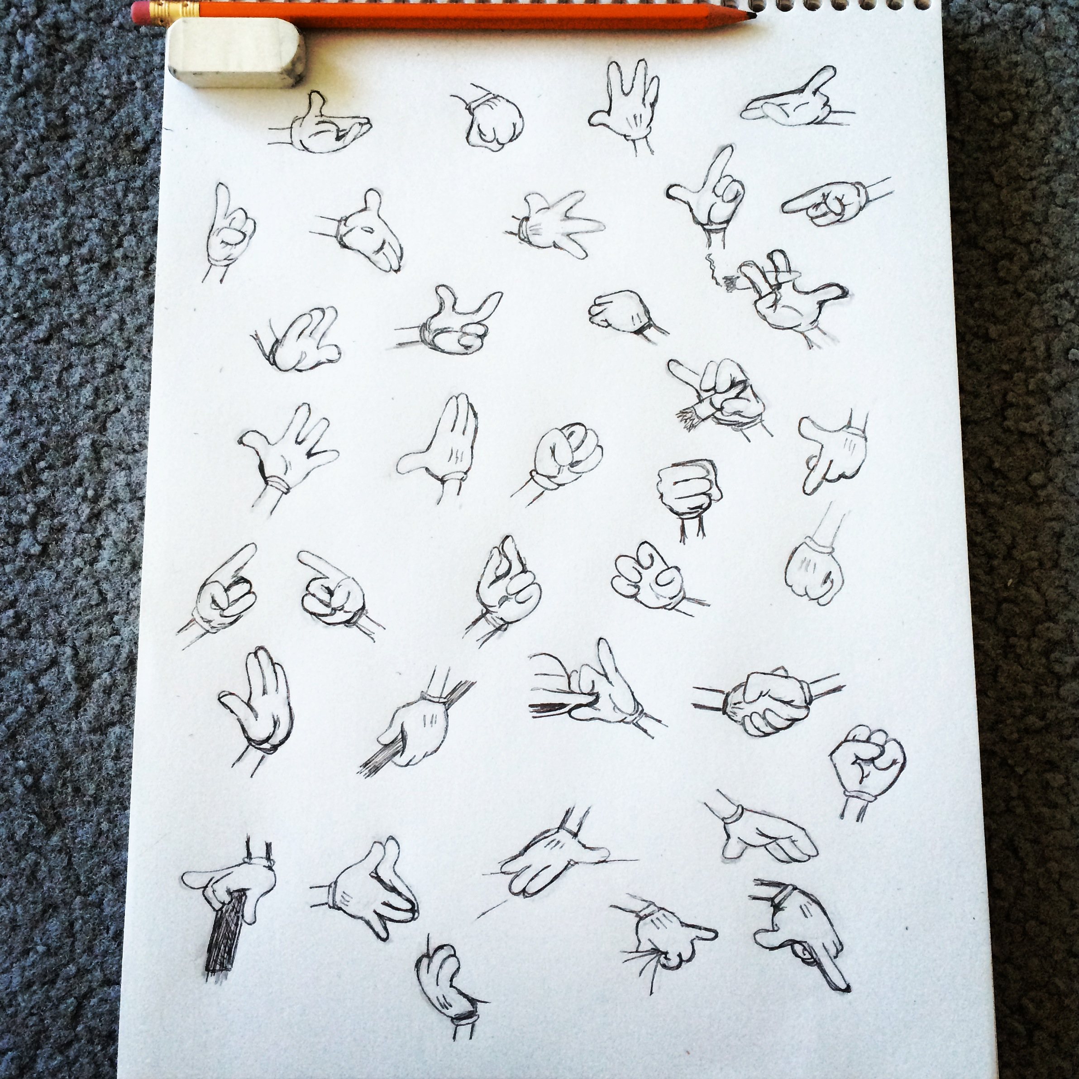

Slide 4
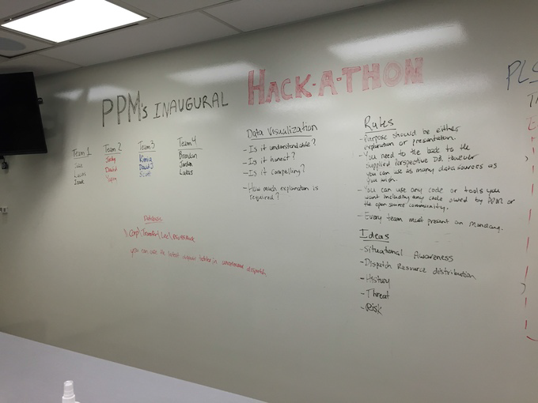
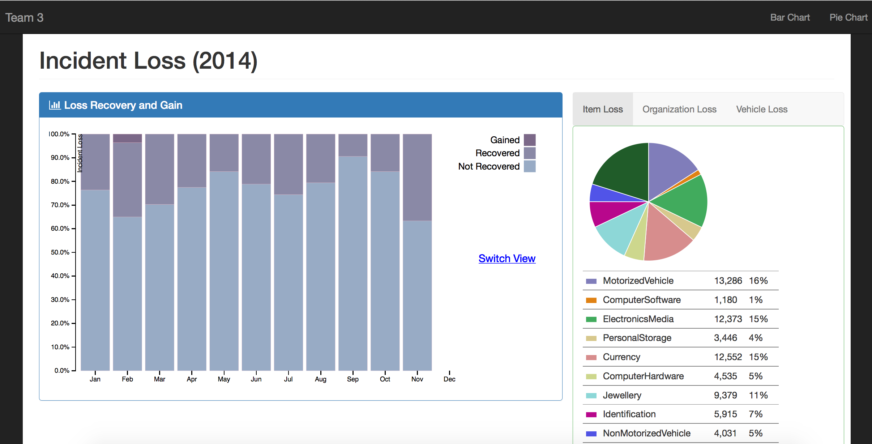
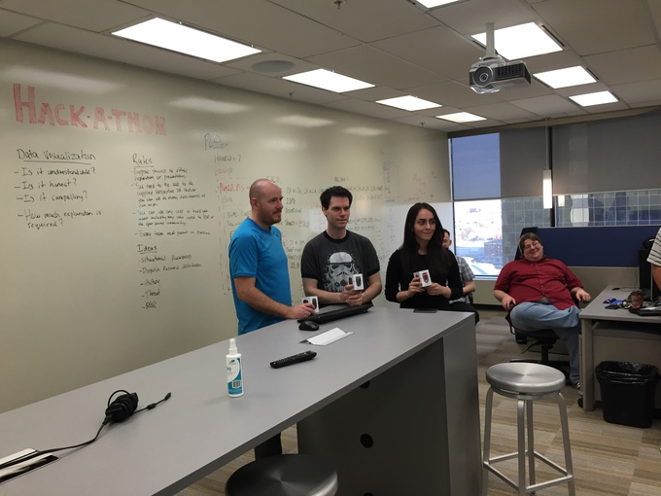
I’m Proud of:
The first ever PPM Hackathon

Slide 5
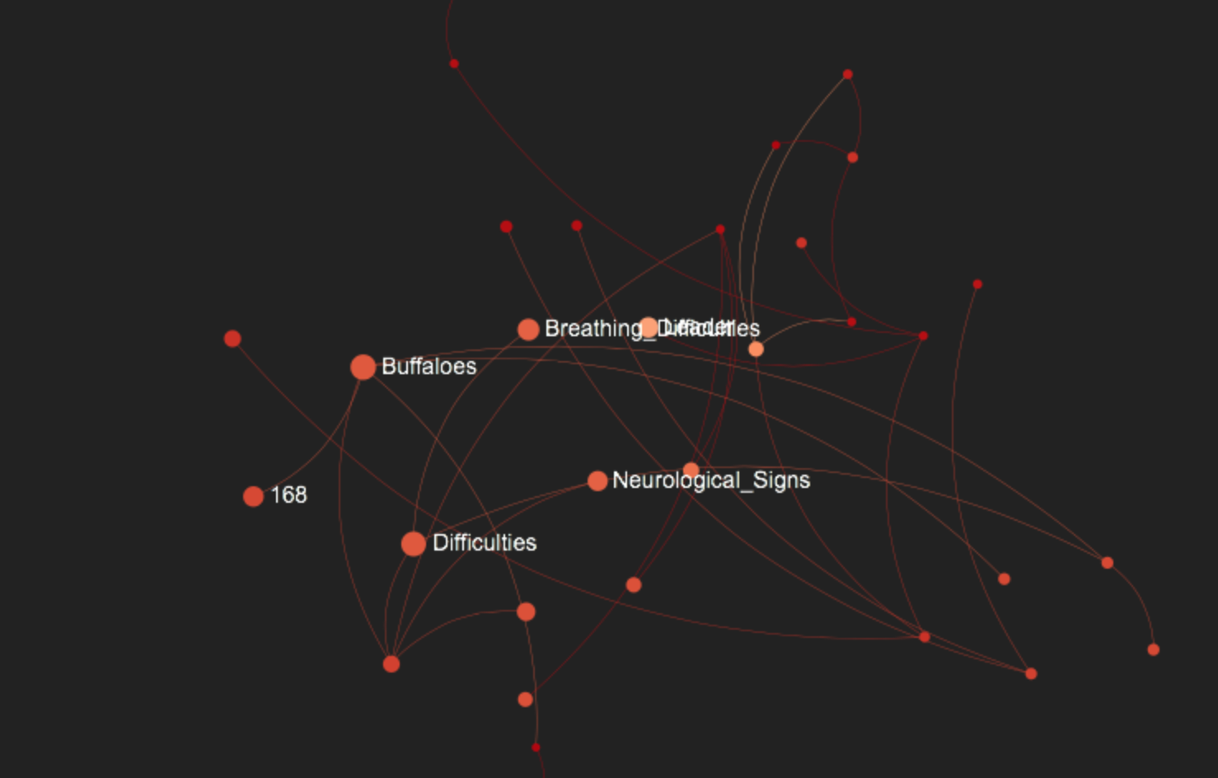
I’m Proud Of
T2R : Text to Graph
Preprocessing
http://t2rdemo.herokuapp.com
Simplifying Sentences
Grammar Parser
Semantic
Parser
RDF
Visualize
Notes:
http://t2rdemo.herokuapp.com

Slide 6
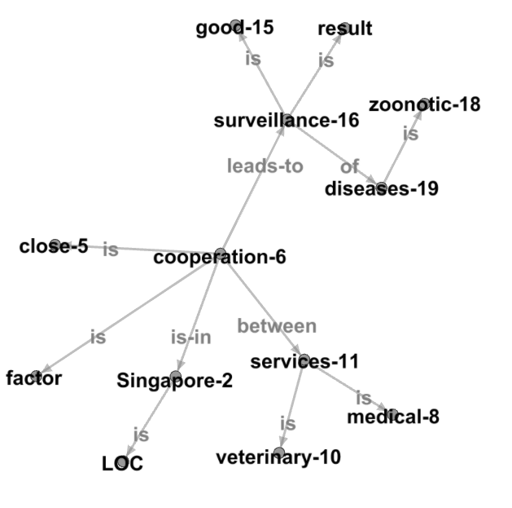
I’m Proud Of
T2R : part 2
in
between
In Singapore there is close cooperation between medical and veterinary services which leads to good surveillance of zoonotic diseases .
cooperation-6 is-in Singapore-2
Singapore-2 is LOC
cooperation-6 between services-11
cooperation-6 is close-5
services-11 is medical-8
services-11 is veterinary-10
surveillance-16 of diseases-19
services-11 is medical-8
surveillance-16 is result
cooperation-6 leads-to surveillance-16
cooperation-6 between services-11
surveillance-16 is good-15
cooperation-6 is close-5
cooperation-6 is factor
diseases-19 is zoonotic-18
services-11 is veterinary-10
Notes:
Grammatical Relations :
Subject, verb, object, prepositions generated by Statistical parser.
Example: cooperation - between - services
Semantic Relations:
Agents, patients, experiencer , theme , locations, temporal, goal
Example : John told a story to Mary.
Speaker: John
Utterance: a story
Hearer: to Mary
NER Entities
LOC, PER, ORG, TMP, …

Slide 7
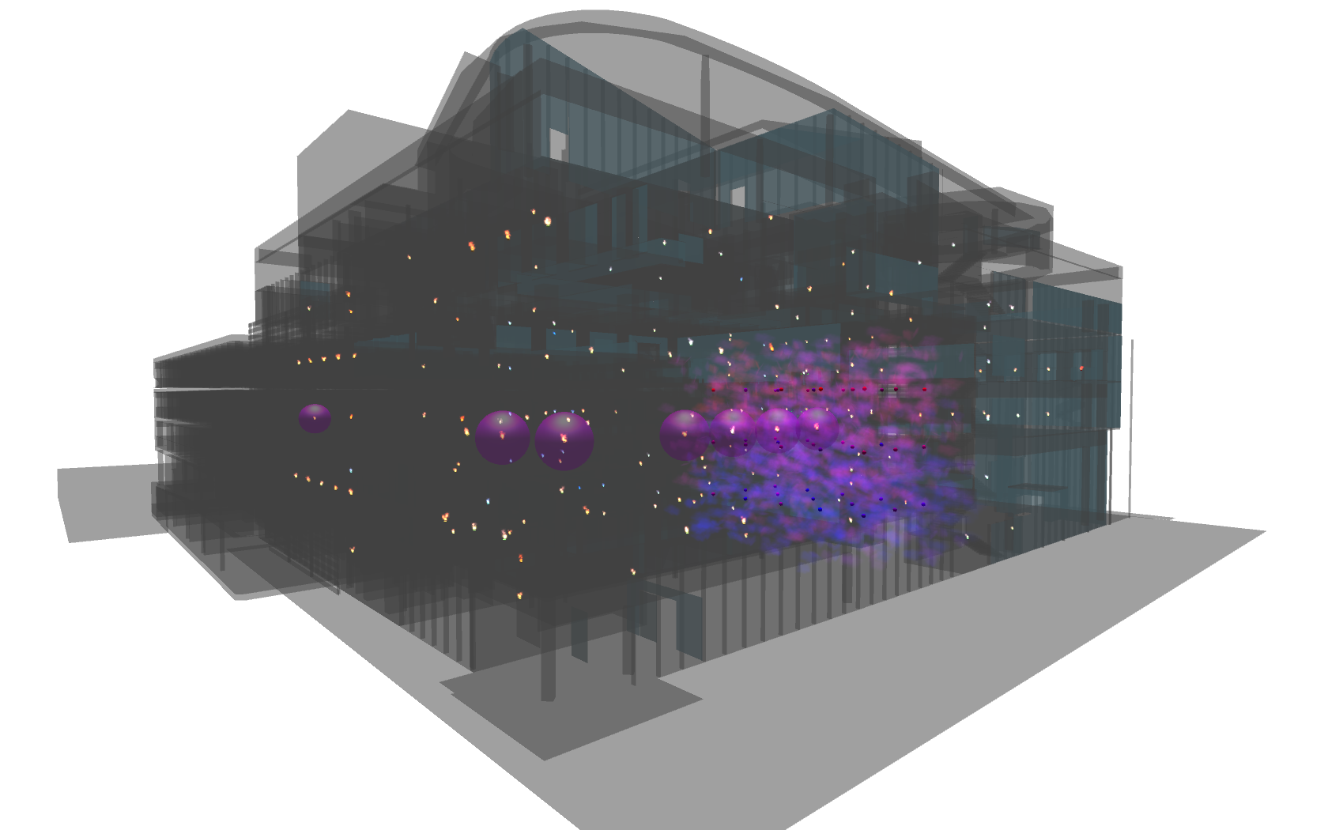
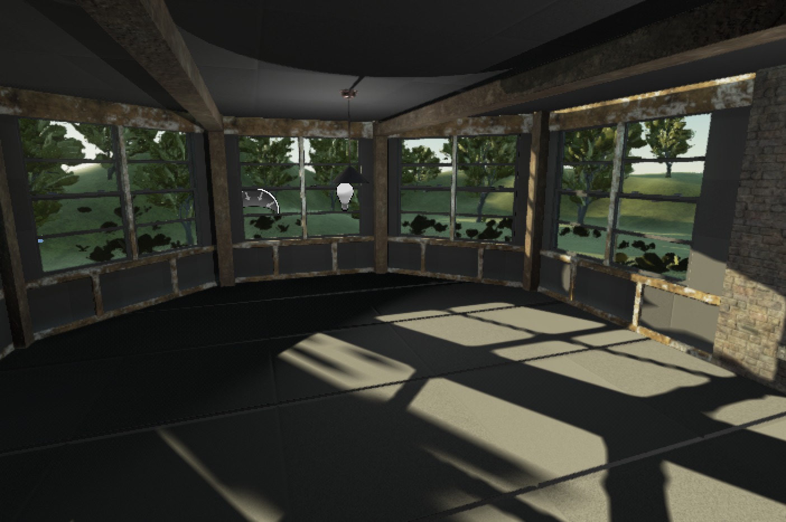
I’m Proud Of
Virtual Room Project (in progress …)
Notes:
DoppelLab is an immersive, cross-reality virtual environment that serves as an active repository of the multimodal sensor data produced by a building and its inhabitants.

Slide 8
Craft Exercise
Building Blocks
Mobile App
B2B App/ Web App
POST equation
POST equation
Equlator
node.js Server
JSON Result
JSON Result

Slide 9
Craft Exercise
Equlator Server Structure
Server.js
Equlator Engine
Process
Convert To Postfix
Start Parsing
Equation
character
Validate
Apply postfix conversion
Push/
Pop
Postfix Array
Continue to read entire equation string
Calculate Postfix
Iterate Postfix Array
Calculate Postfix
Result Stack
character
Push/
Pop
Continue to the end of array

Slide 10
Craft Exercise
Validation :
1- Any character other than 0..9 + - / * .
invalid character ASCII code is not in range [40-57] except 44 , that is comma “ , “
2- If * or / appear after opening parenthesis (
Example: (* and (/ are invalid
3- If number of “ ) “ doesn’t match number of “ ( “
parenthesisStack keeps track of “(“, when parser reads “ ) ” it pops 1 “ ( “ from top of parenthesisStack
4- Multiple decimal points in 1 number is invalid
Example: 2.3.5 is invalid
a Boolean variable decimalPointExists is used for detecting the first occurrence of “ . ”
5- “ ) ” after decimal point is invalid
Example: (2.) is invalid
6- Blank space in equation is also invalid
Example: 2 + 2 is invalid , 2+2 is valid

Slide 11
Craft Exercise
PostFix Conversion Algorithm:
Only passes through if character is validated
Using helper Stack and postfix array to convert infix to postfix
Associated Priorities: “(” : 0 , “)”: 1 , “+”: 2 , “-”: 2 , “/” : 3 , “*”: 4, “number”:4
1- if character is Operator (using ASCII code to find out)
- push a json object with value, type & priority of operand to a helper Stack
if priority associated to this object is less or equal than top of helper Stack, do a while loop and pop top from helper Stack and push it to postfix array
and then push new object to helper Stack
Example json object { value: “+” , type: “Operator”, priority: 2}
2-else if character is number or decimal (using ASCII code to find out)”
- if decimal pop last item from postfix, and append . to it, then push it back to postfix
note: .2 is converted to 0.2
- if it’s a number push an object with its value, type, priority to postfix.
Example json object { value: “0.2” , type: “Operand”, priority: 4}
3- else if character is “(“
push it to helper stack with json object of its value, type, priority
push it to parenthesis stack for validation purpose

Slide 12
Craft Exercise
PostFix Conversion Algorithm:
4- else character is “ ) “
do a while loop to pop items from helper stack and push them to postfix , until it reaches “ ( “
pop a “ ( “ parenthesis stack
5- pop anything remained in helper stack and push it to postfix
Example: 2*(3*4+2) → 2 3 4 * 2+ *
4
4
*
3
3
(
3
(
3
(
2
2
*
2
*
2
*
2
*
2
*
p
h
p
h
p
h
p
h
p
h
p
h
+
)
+
+
*
*
+
*
2
2
2
4
*
4
+
4
+
+
*
*
*
3
(
3
(
3
(
4
(
4
4
2
*
2
*
2
*
3
3
*
3
2
*
2
2
p
h
p
h
p
h
p
h
p
h
p
h

Slide 13
Craft Exercise
Calculate postfix:
Start reading postfix array from beginning
1- if it’s operator , pop 2 previous items from stack, apply the operator and push them back to stack
2- if it’s operand, push it to stack
Note: Operands are in string format, and bignumber.js npm library is used to deal with Big Numbers
Example: 2 3 4 * 2+ * → 28
4
3
3
12
2
2
2
2
2
14
14
28
p
p
p
p
p
p
p

Slide 14
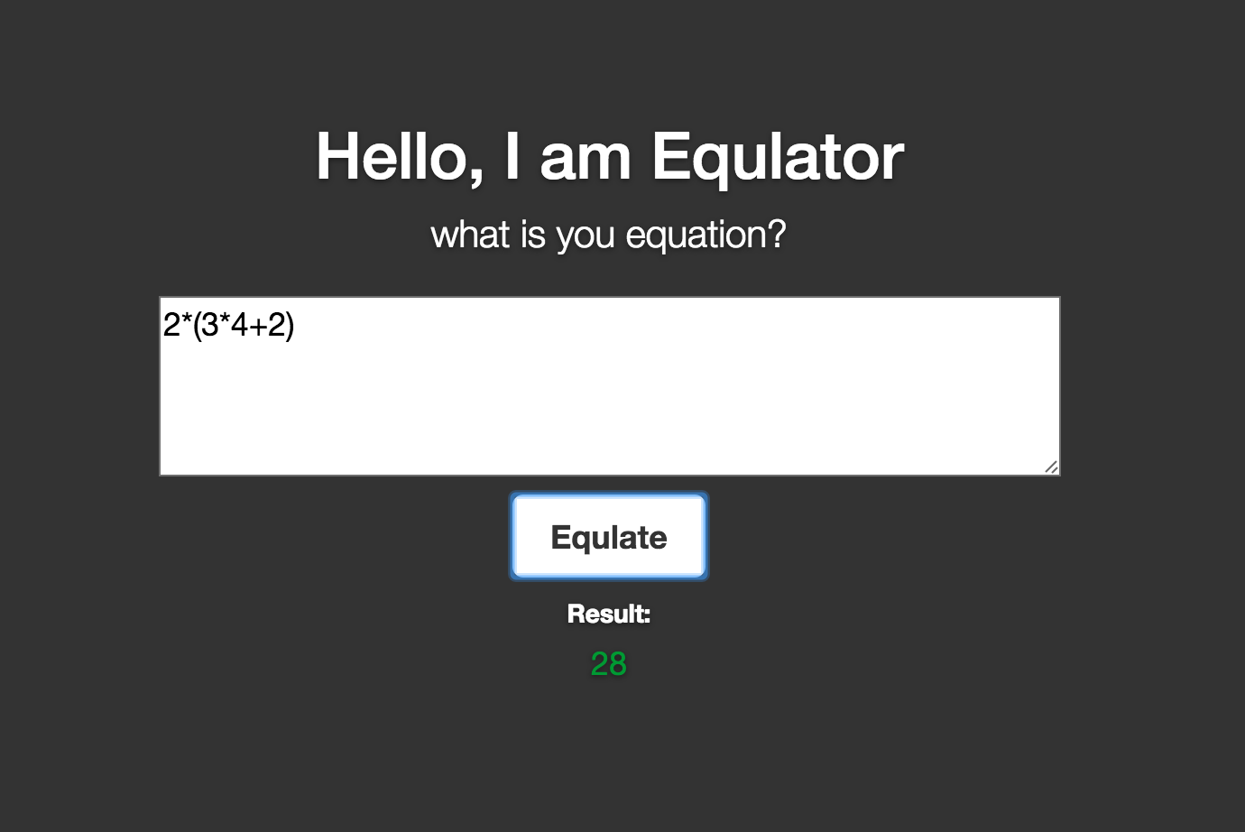
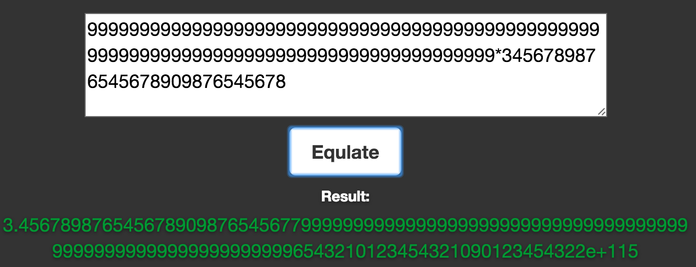
Equlator WebApp Demo

Slide 15
Mobile Calculator App
Used Android Studio
- Connects to Equlator server that is running on port 3000
by Sending a GET request to http://192.168.1.70:3000/
Equation is an empty string
Buttons are bound to a method to append character to equation string
By pressing “=“ button on calculator, app sends a Post Request to Equlator Server, and receives response in json format
Memory is an empty string to cache result
MR button reads memory
MC button clears memory
MS button saves result to memory

Slide 16
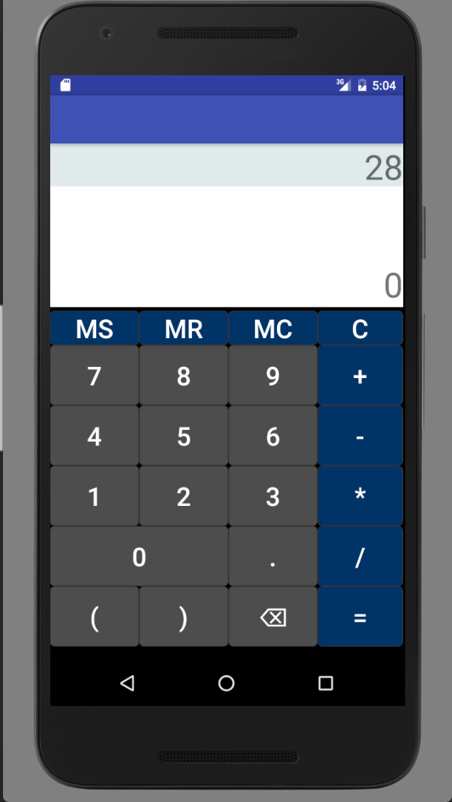
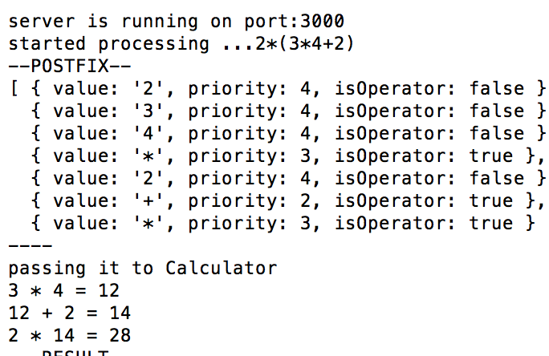
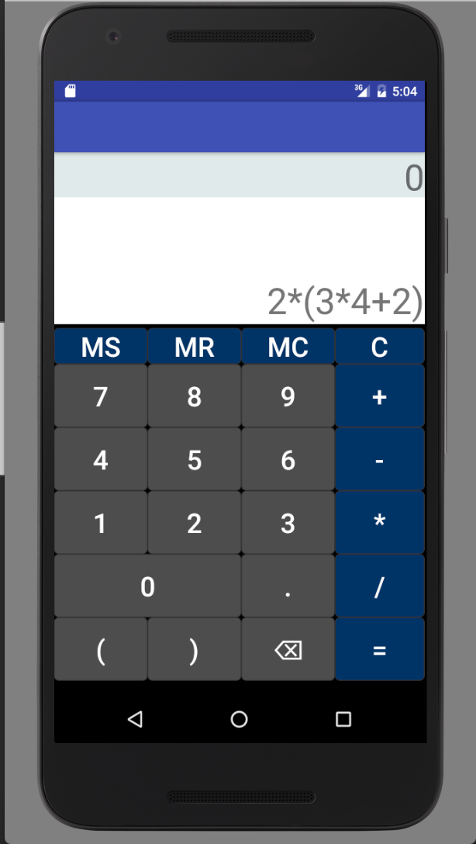
Android Calculator Demo

Slide 17
B2B Car Rental Service
Used nodejs
Speedy Car Rental Services Application runs on port 5000
- Connects to Equlator server that is running on port 3000
by Sending a GET request to http://192.168.1.70:3000/
Equation is an empty string
Form allows user to pick a car type and selects different options and number of days, a default promotional code (5%) is applied.
Car Types & Price:
Economy (34.99$ per day)
Intermediate (36.99$ per day)
Premium (40.99$ per day)
Insurance (40.50 $ per day), Collision Damage Package (6.99$ per day), GPS(24.99$ per day)
Default Promotional Code 5%
Default Tax & Fees 8%

Slide 18
B2B Car Rental Service
By clicking on Estimate button Equation is created:
Formula:
withoutPromotion = numberOfDays *( carPrice + insurance + collisionDamage + GPS)
withoutTax= withoutPromotion - (withoutPromotion * defaultPromotion)
total = withoutTax + withoutTax * defaultTax

Slide 19
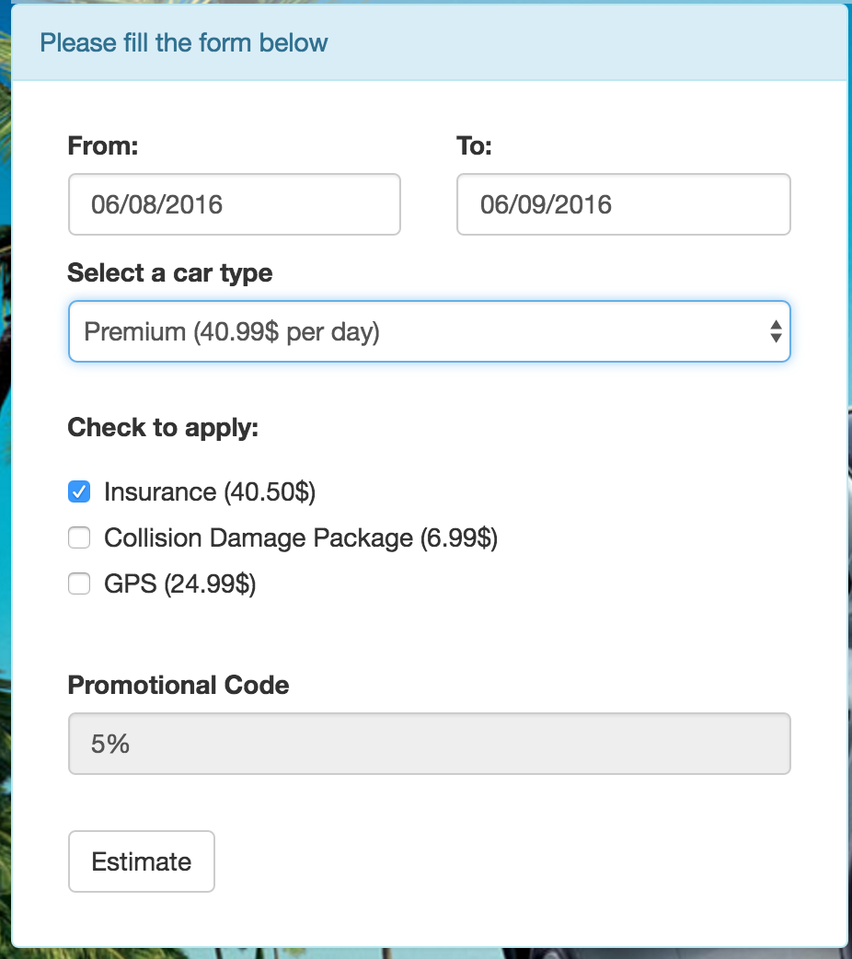

Slide 20
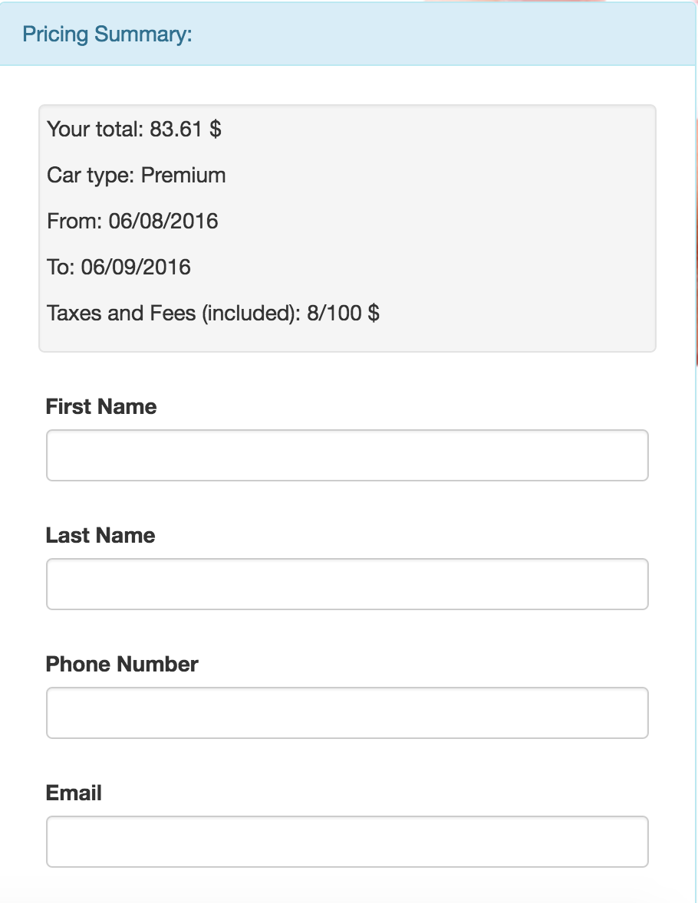

Slide 21
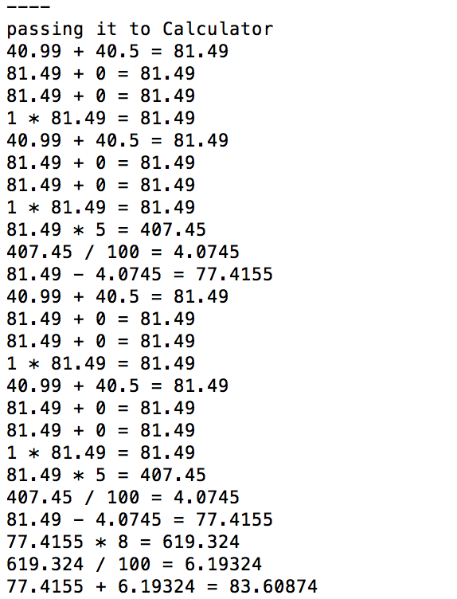
Crazy Terminal

Slide 22
Thank You !
Questions & Demo

